Slide 2

Ypp 4
bbv Software Services AG | Date: 21/07/2025

Slide 3




Presentation on MS Lists Functionalities
bbv Software Services AG | Date: 21/07/2025

Slide 4
Agenda
Introduction
Key Functionalities
Q&A

Slide 5

Introduction
What is MS Lists?

Slide 6
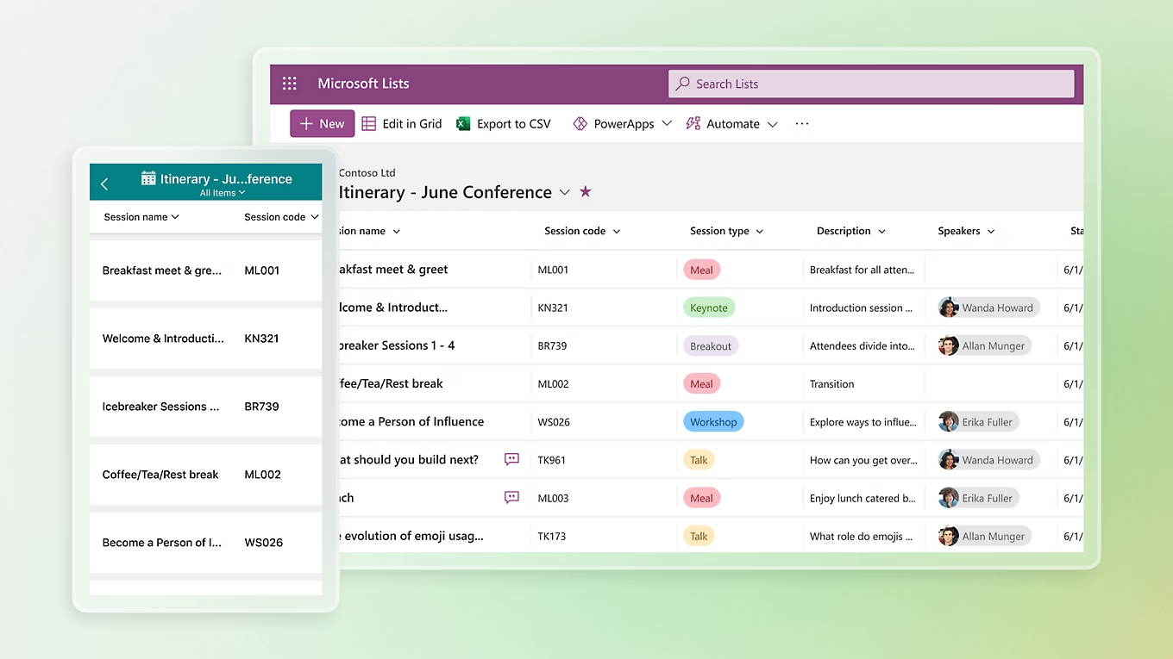
Introduction
What is Microsoft Lists
MS List is a tool for managing structured lists of data
Works like a simple table or database
Let’s users:
Create lists
View data
Manage info clearly and easily

Slide 7

Key Functionalitie

Slide 8
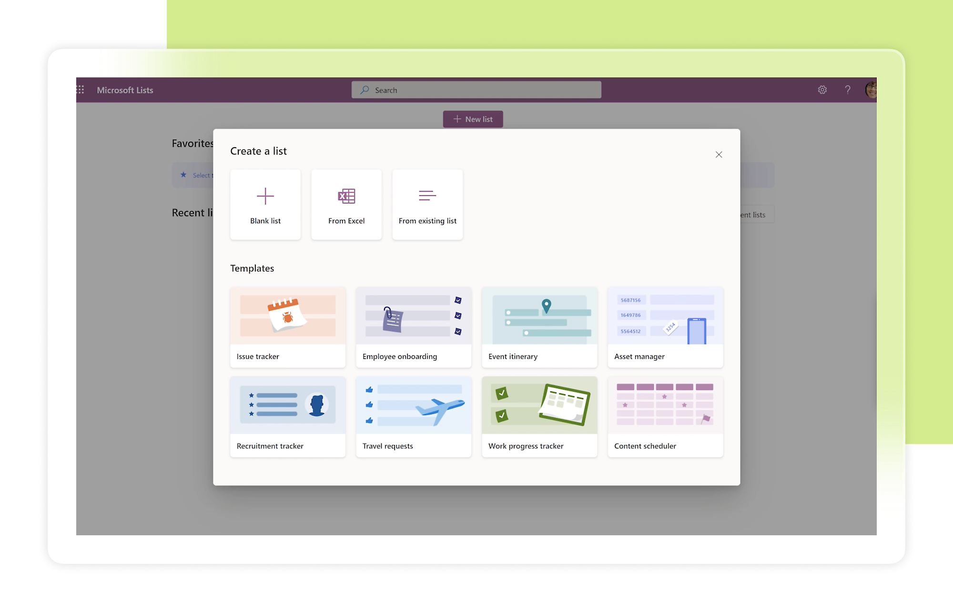
Key Functionalities of MS Lists
Create and Manage Lists
Custom Columns
Manage List Items
Custom Views
Conditional Formatting
Permissions and Sharing
Built-in Templates

Slide 9
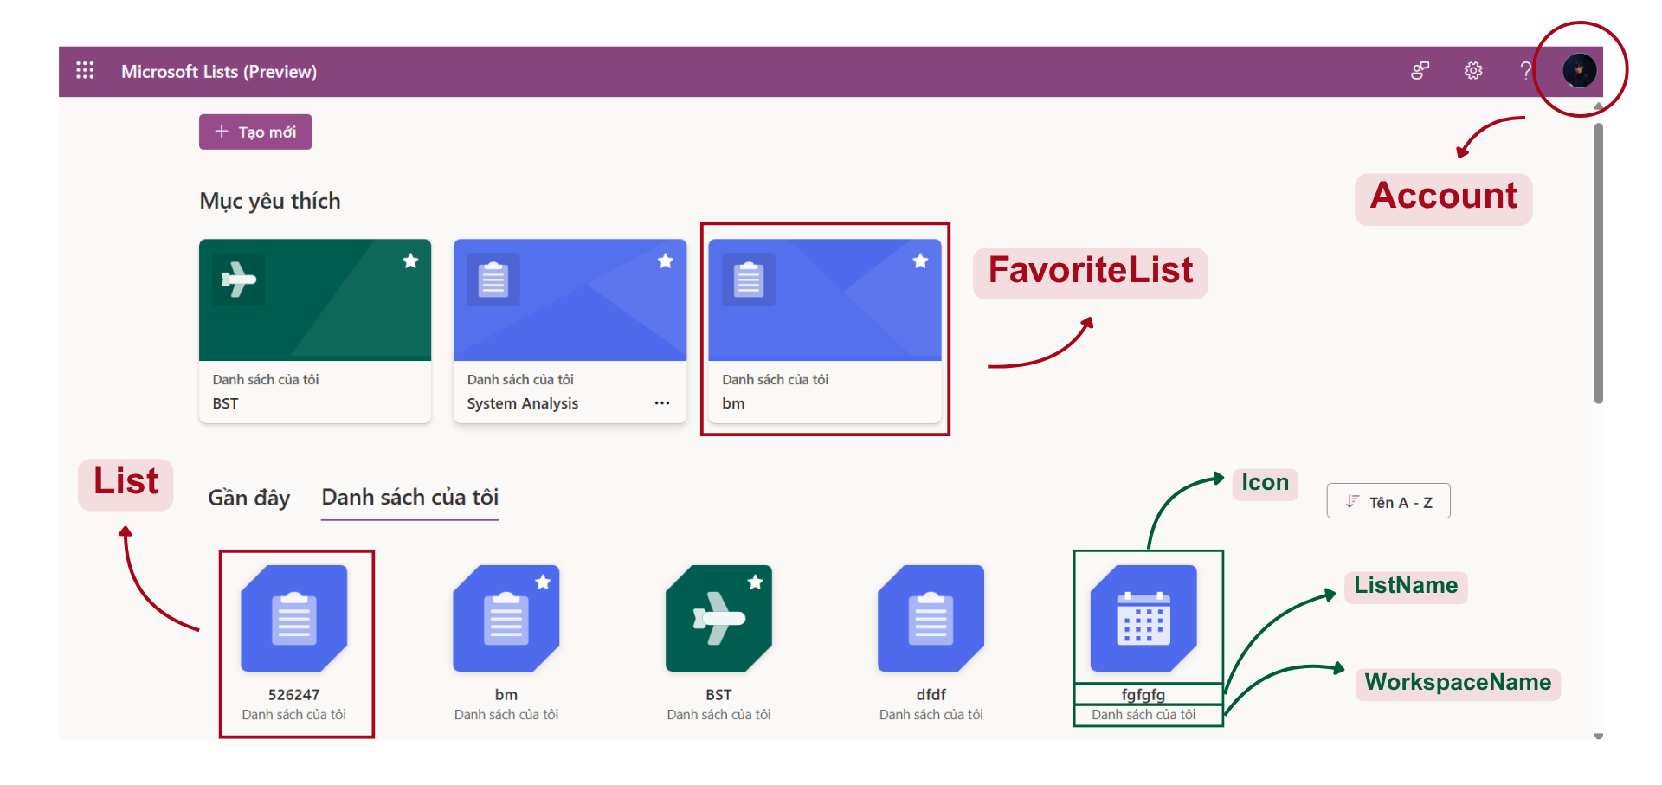
Dashboard Screen
Notes:
-- Dashboard Screen
-- Get information of user 1
SELECT acc.id, acc.Avatar, acc.FirstName, acc.LastName, acc.Company, acc.AccountStatus
FROM
Account AS acc
WHERE acc.Id = 1
-- Get personal lists of user 3
SELECT l.Id, l.Color, l.Icon, l.ListName, l.ListStatus, l.CreateBy, l.CreateAt
FROM
List AS l
INNER JOIN
Account AS acc ON l.CreateBy = acc.Id
WHERE
acc.Id = 3
ORDER BY
l.CreateAt ASC
-- Get favorite lists of user 3
SELECT
l.Id, l.Color, l.Icon, l.ListName, l.ListStatus, l.CreateBy, l.CreateAt
FROM
List AS l
INNER JOIN
Account AS acc ON l.CreateBy = acc.Id
WHERE
acc.Id = 3
ORDER BY
l.CreateAt ASC;

Slide 10
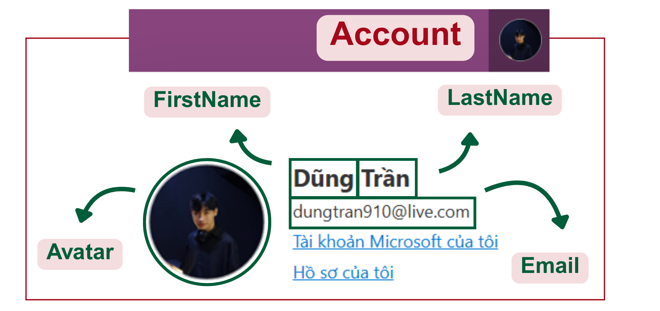
Dashboard Screen
Notes:
-- Dashboard Screen
-- Get information of user 1
SELECT acc.id, acc.Avatar, acc.FirstName, acc.LastName, acc.Company, acc.AccountStatus
FROM
Account AS acc
WHERE acc.Id = 1

Slide 11
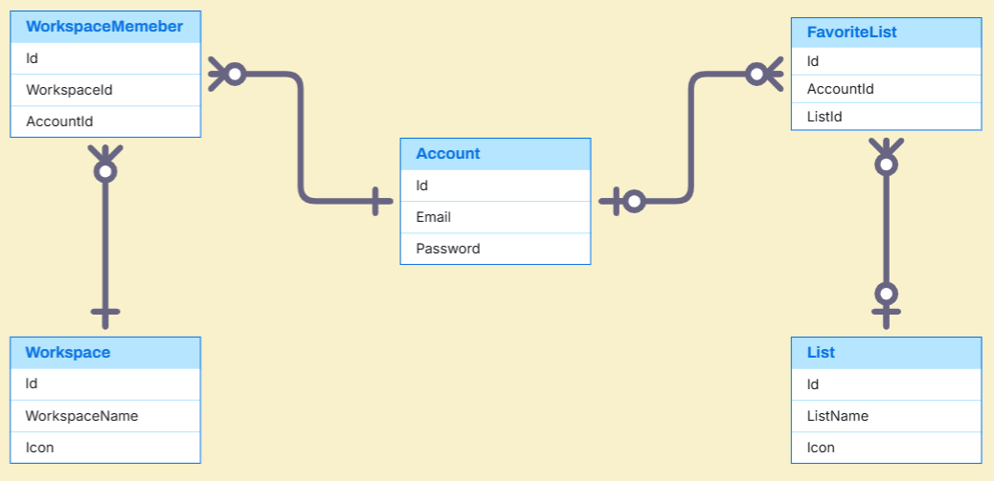
Dashboard Entities

Slide 12
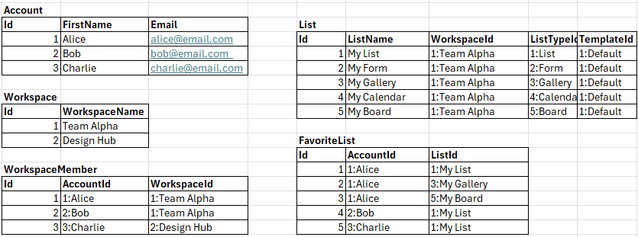
Dashboard Sample Data

Slide 13
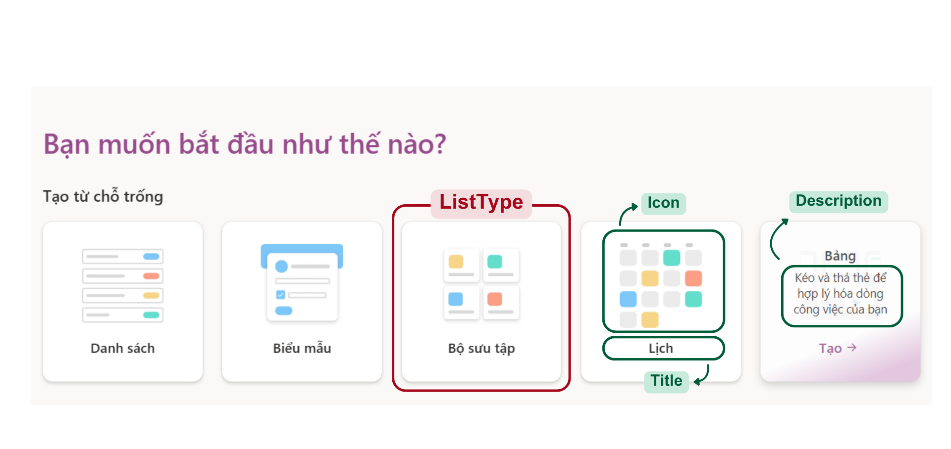
Create List Screen
Notes:
-- Create List
-- Get all list types
SELECT lt.Id, lt.Icon, lt.Title, lt.[Description] FROM ListType lt

Slide 14
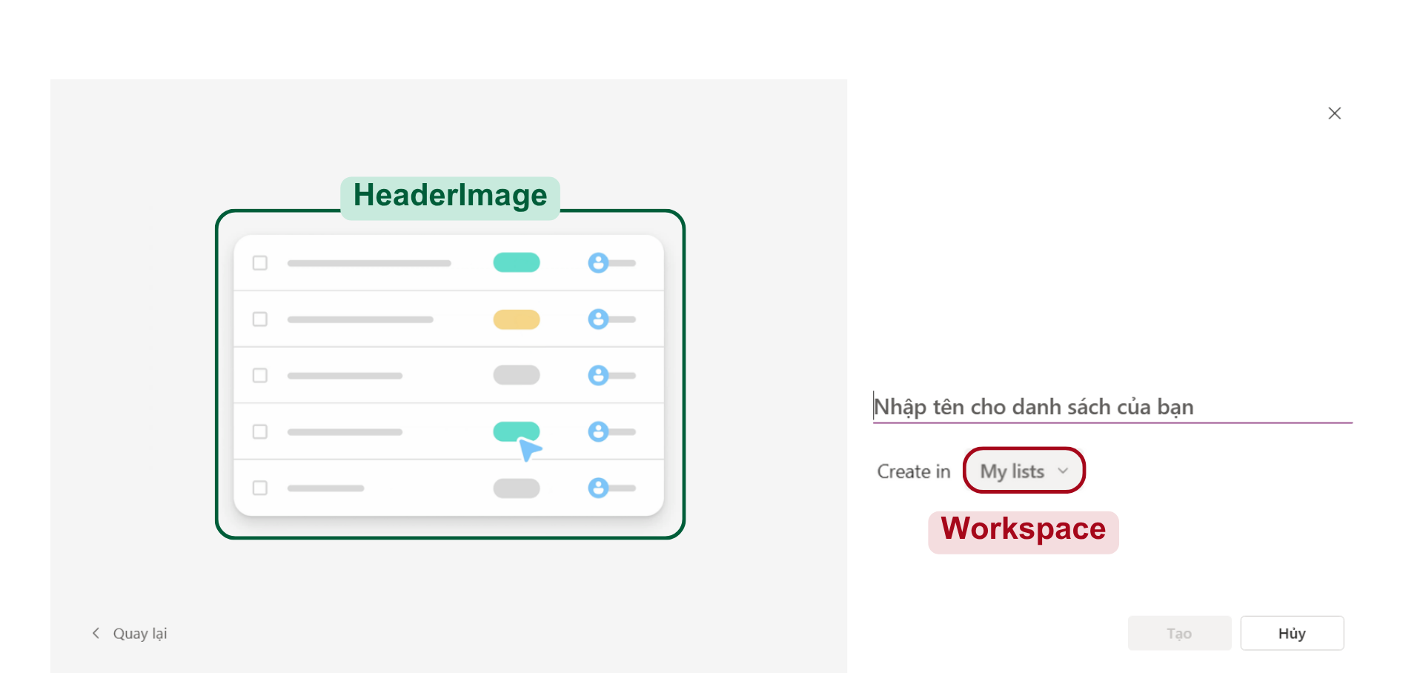
Create List From List Type
Notes:
-- Create List From List Type
-- Get HeaderImage of a specific list type
SELECT
lt.Id, lt.HeaderImage
FROM
ListType lt
WHERE
lt.Id = 1
-- Get all workspaces of a specific user
SELECT
w.Id AS WorkspaceId, w.WorkspaceName, wm.AccountId AS UserId
FROM
WorkspaceMember wm
INNER JOIN
Workspace w ON wm.WorkspaceId = w.Id
WHERE
wm.AccountId = 3
ORDER BY
wm.Id DESC;

Slide 15
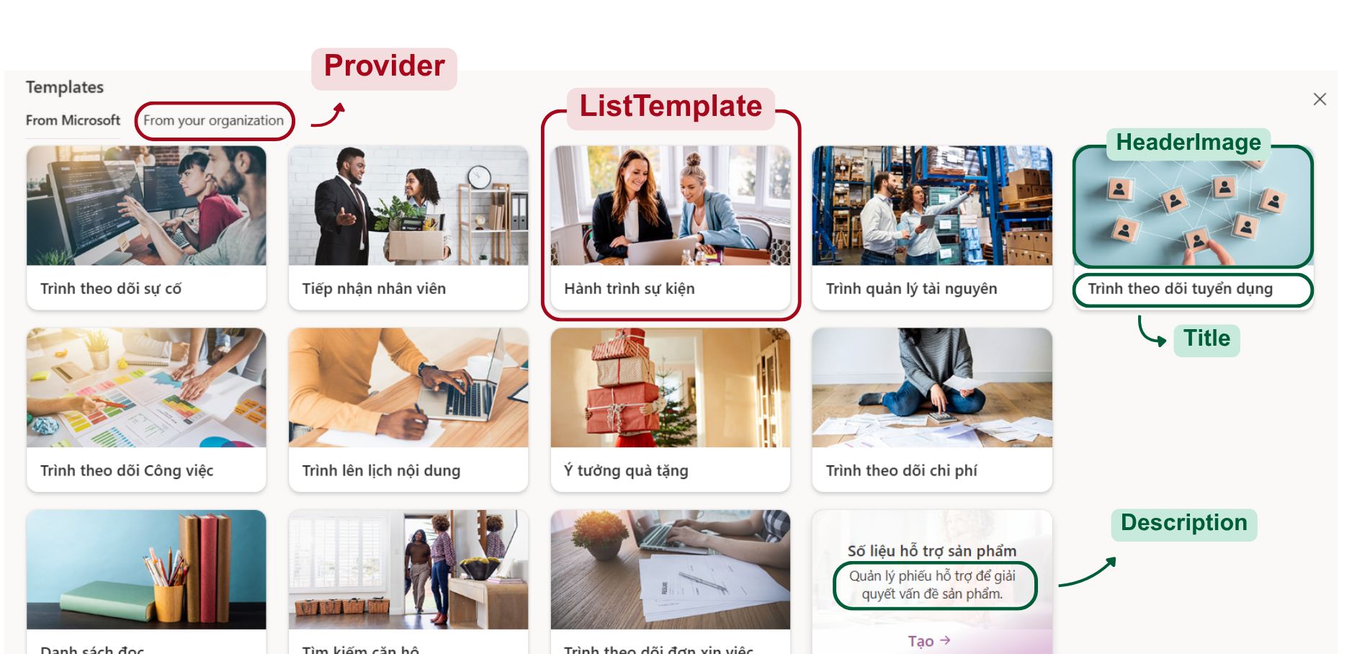
Create List Screen
Notes:
-- Create List
-- Get all providers
SELECT tp.Id, tp.ProviderName FROM TemplateProvider tp
-- Get all templates of a specific provider
SELECT
tp.Id, tp.ProviderName, lt.Id,lt.Title, lt.[Description], lt.HeaderImage
FROM
TemplateProvider tp
INNER JOIN
ListTemplate lt ON tp.Id = lt.ProviderId
WHERE
tp.Id = 1;

Slide 16
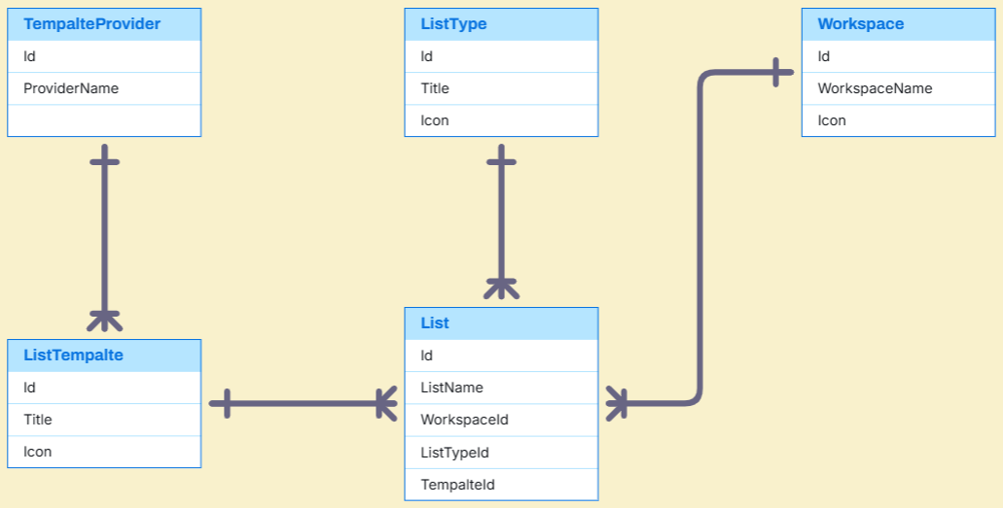
Create List Sample Data

Slide 17
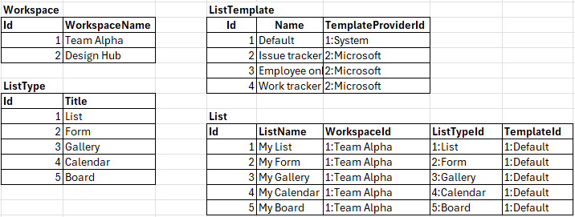
Create List Sample Data

Slide 18
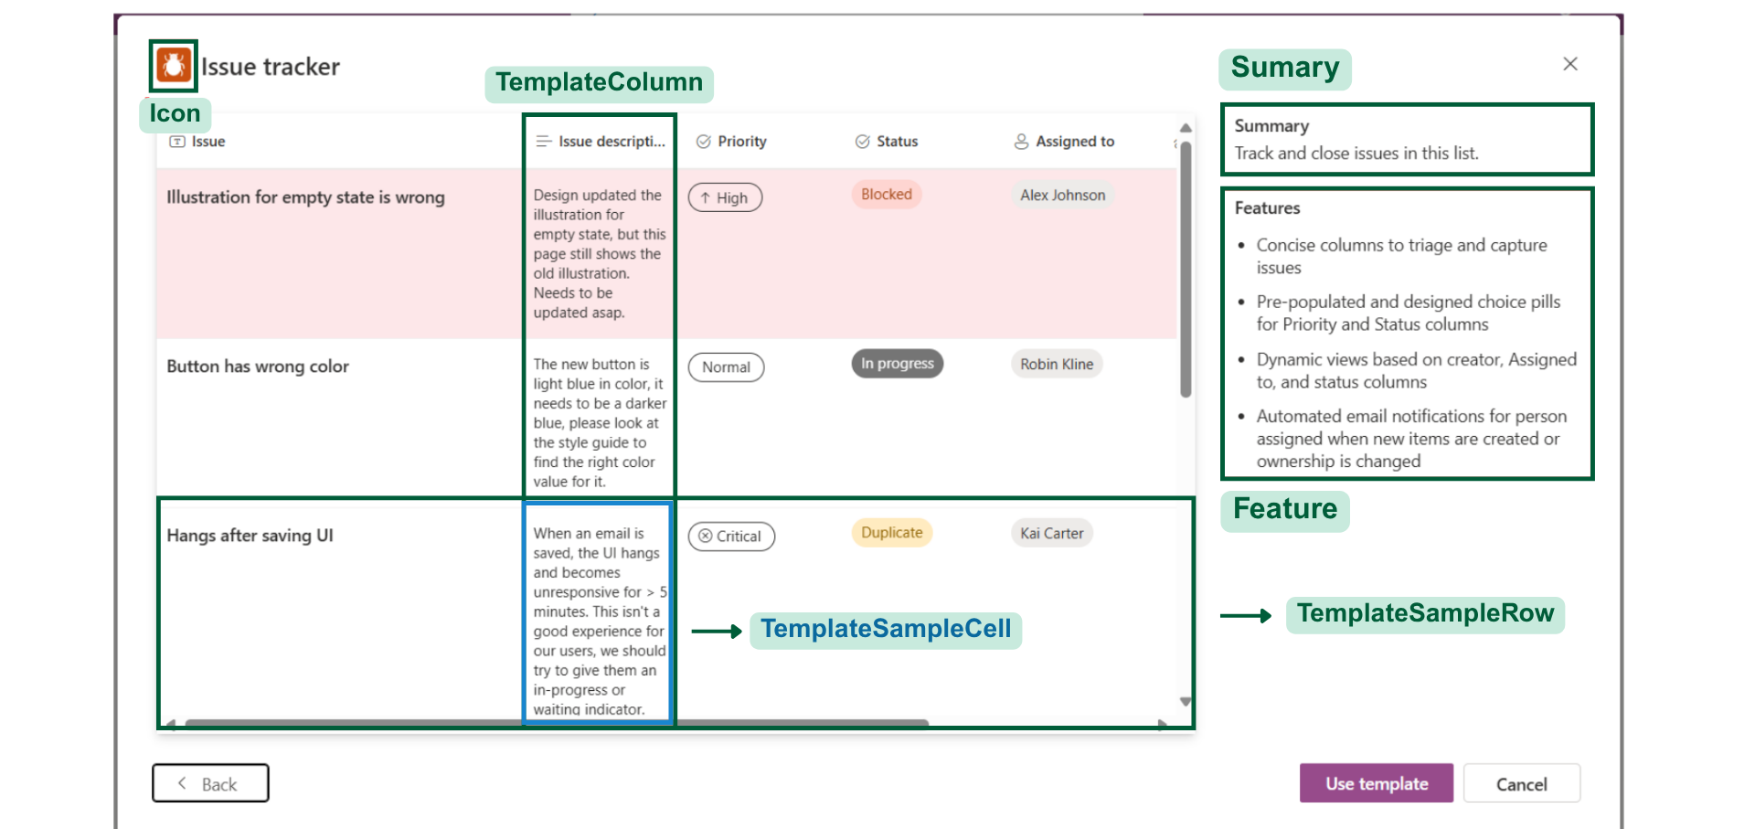
Create List From Template
Notes:
-- Create List From Template
-- Get basic information of a specific template
SELECT
lt.Id, lt.Title, lt.Icon, lt.Summary, lt.Feature
FROM
ListTemplate lt
WHERE
lt.Id = 1
-- Get sample data of a specific template
SELECT
tcol.Id AS colId,
tcol.ColumnName,
sdt.Icon,
trow.Id rowid,
tcell.CellValue,
tcol.ListTemplateId
FROM
TemplateColumn tcol
INNER JOIN
SystemDataType sdt ON tcol.SystemDataTypeId = sdt.Id
INNER JOIN
TemplateSampleRow trow ON tcol.ListTemplateId = trow.ListTemplateId
INNER JOIN
TemplateSampleCell tcell
ON tcol.Id = tcell.TemplateColumnId
AND trow.Id = tcell.TemplateSampleRowId
WHERE
tcol.ListTemplateId = 1

Slide 19
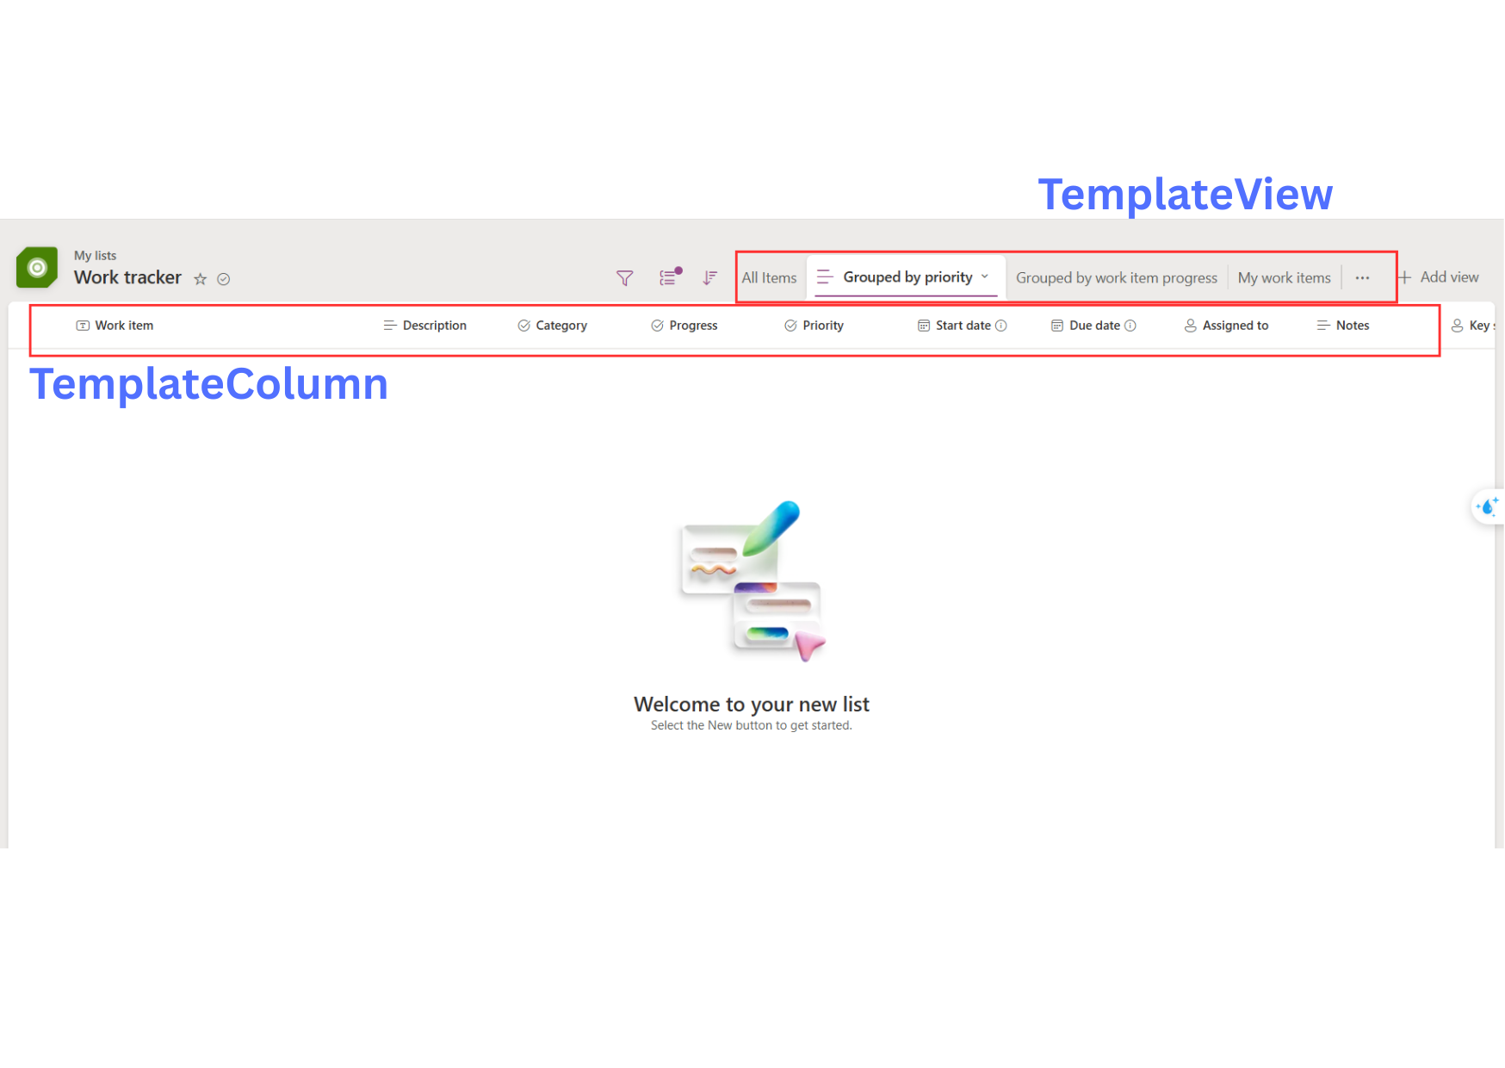
Template View & Template Column
Notes:
-- Create List From Template
-- Get all views of a template
SELECT
tv.Id,
tv.ViewName,
tv.ViewTypeId,
vt.Icon,
vs.SettingKey,
tvs.GroupByColumnId,
tvs.RawValue
FROM
TemplateView tv
INNER JOIN
ViewType vt ON tv.ViewTypeId = vt.Id
LEFT JOIN
TemplateViewSetting tvs ON tv.Id = tvs.TemplateViewId
LEFT JOIN
ViewTypeSetting vts ON tvs.ViewTypeSettingId = vts.Id
LEFT JOIN
ViewSetting vs ON vts.ViewSettingId = vs.Id
WHERE
tv.ListTemplateId = 1
ORDER BY
tv.DisplayOrder
-- Get all columns of a template and their setting value
SELECT
tc.Id, tc.ColumnName, sdt.Icon, ks.KeyName, tcsv.KeyValue
FROM
TemplateColumn tc
INNER JOIN
SystemDataType sdt ON tc.SystemDataTypeId = sdt.Id
LEFT JOIN
TemplateColumnSettingValue tcsv ON tc.Id = tcsv.TemplateColumnId
LEFT JOIN
DataTypeSettingKey dtsk ON tcsv.DataTypeSettingKeyId = dtsk.Id
LEFT JOIN
KeySetting ks ON dtsk.KeySettingId = ks.Id
WHERE
tc.ListTemplateId = 1
ORDER BY
tc.DisplayOrder
-- Get all column setting object of needed columns (choice)
SELECT
lcso.Id,
lcso.DisplayName,
lcso.DisplayColor,
lcso.DisplayOrder
FROM
ListColumnSettingObject lcso
INNER JOIN
TemplateColumn tc ON lcso.ColumnId = tc.Id
WHERE
lcso.Context = 'TEMPLATE'
AND tc.ListTemplateId = 1;

Slide 20
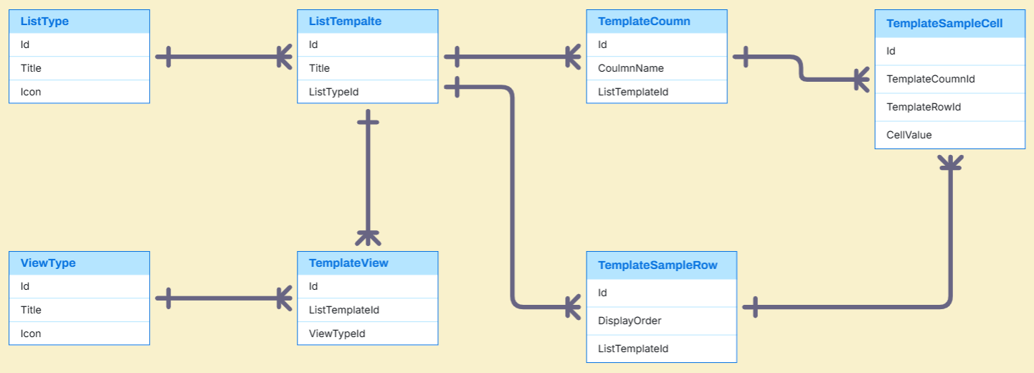
Template Entities

Slide 21
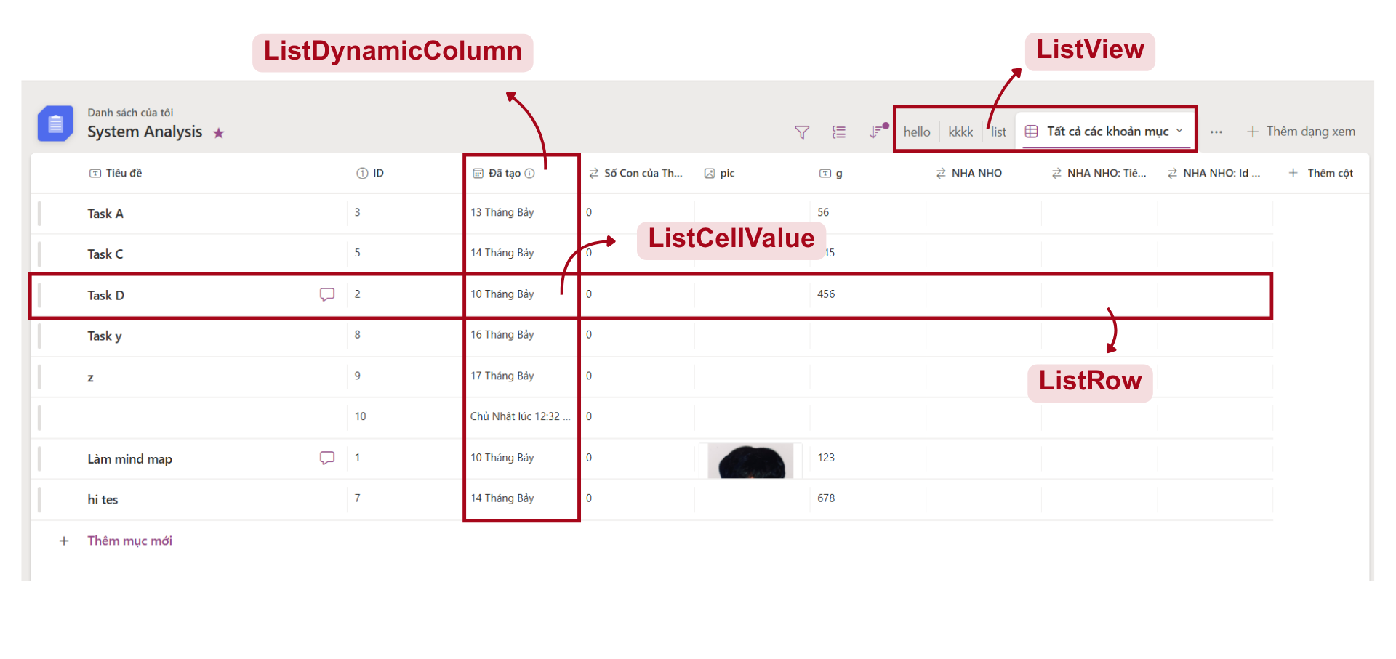
List Management
Notes:
-- List Management
-- Get all data of a specific list
SELECT
lc.Id AS ColumnId,
sdt.Icon AS ColumnIcon,
lc.ColumnName AS ColumnName,
lr.Id AS RowId,
lcvl.[Value] AS CellValue
FROM
ListDynamicColumn AS lc
INNER JOIN
ListRow AS lr ON lc.ListId = lr.ListId
INNER JOIN
ListCellValue AS lcvl ON lcvl.ListColumnId = lc.Id AND lcvl.ListRowId = lr.Id
INNER JOIN
SystemDataType AS sdt ON lc.SystemDataTypeId = sdt.Id
WHERE
lc.ListId = 1
ORDER BY lc.DisplayOrder ASC, lr.DisplayOrder ASC
-- Get all column setting object of needed columns (choice)
SELECT
lcso.Id,
lcso.ColumnId AS ListDynamicColumnId,
lcso.DisplayName,
lcso.DisplayColor,
lcso.DisplayOrder,
lcso.Context
FROM
ListColumnSettingObject lcso
INNER JOIN
ListDynamicColumn ldc ON lcso.ColumnId = ldc.Id
WHERE
lcso.Context = 'LIST'
AND LDC.ListId = 1;
-- Get all datatype settings of a specific column
SELECT
ks.Id,
ks.KeyName,
ks.DefaultValue,
ks.ValueType,
lcsv.KeyValue
FROM
KeySetting ks
INNER JOIN
DataTypeSettingKey dtsk ON ks.Id = dtsk.KeySettingId
LEFT JOIN
ListColumnSettingValue lcsv
ON dtsk.Id = lcsv.DataTypeSettingKeyId
AND lcsv.ColumnId = 1
WHERE
dtsk.DataTypeId = 1;
-- Get all views of a specific list
SELECT
lv.Id, lv.ViewName, vt.Icon
FROM
ListView lv
INNER JOIN
ViewType vt ON lv.ViewTypeId = vt.Id
WHERE
lv.ListId = 1
ORDER BY
lv.DisplayOrder ASC
-- Get all view settings of a specific list view
SELECT
vs.Id,
vs.SettingKey,
vs.ValueType,
lvs.ListViewId,
lvs.GroupByColumnId,
lvs.RawValue
FROM
ViewSetting vs
INNER JOIN
ViewTypeSetting vts ON vs.Id = vts.ViewSettingId
LEFT JOIN
ListViewSetting lvs
ON vts.Id = lvs.ViewTypeSettingId
AND lvs.ListViewId = 1
WHERE
vts.ViewTypeId = 4

Slide 22
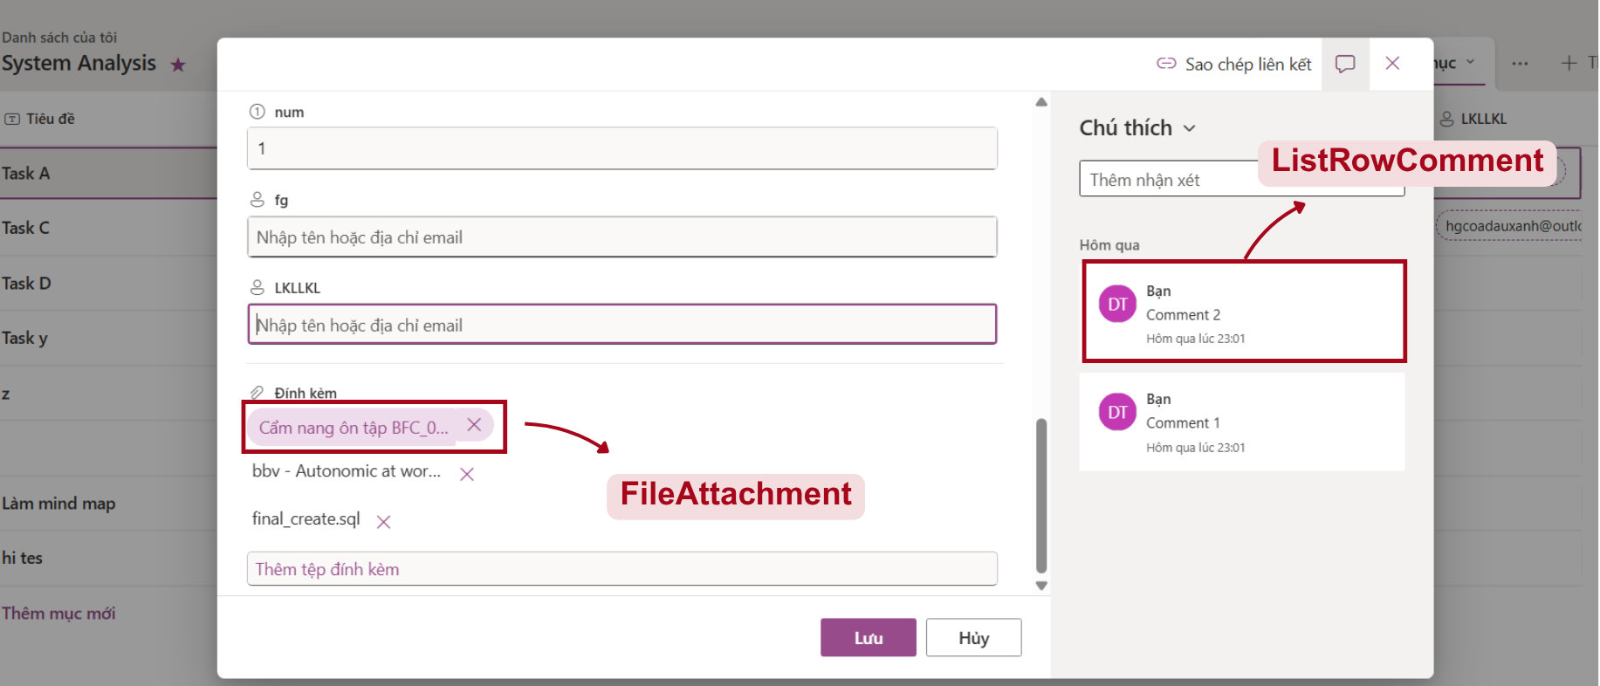
List Row Detail
Notes:
-- List Management
-- Get all comment of a row
SELECT
lrc.Id AS RowId, a.Avatar, a.FirstName, a.LastName, lrc.Content, lrc.UpdateAt
FROM
Account a
INNER JOIN
ListRowComment lrc ON a.Id = lrc.CreatedBy
WHERE
lrc.ListRowId = 1
ORDER BY
lrc.UpdateAt DESC
-- Get all attachment files of a row
SELECT
fa.Id, fa.[FileName], fa.FileUrl
FROM
FileAttachment fa
WHERE
fa.ListItemId = 1
ORDER BY
fa.CreateAt DESC

Slide 23
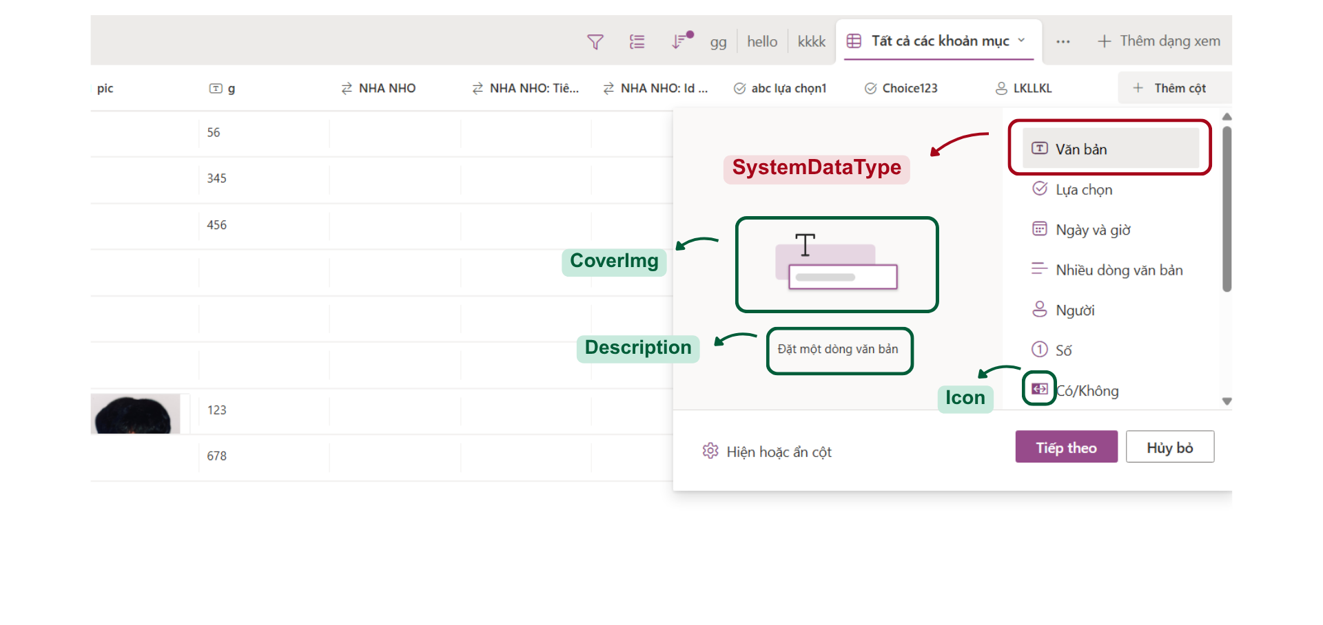
List Column
Notes:
-- List Management
-- Get all system data types
SELECT
sdt.Id, sdt.Icon, sdt.[Description], sdt.DisplayName
FROM
SystemDataType sdt

Slide 24
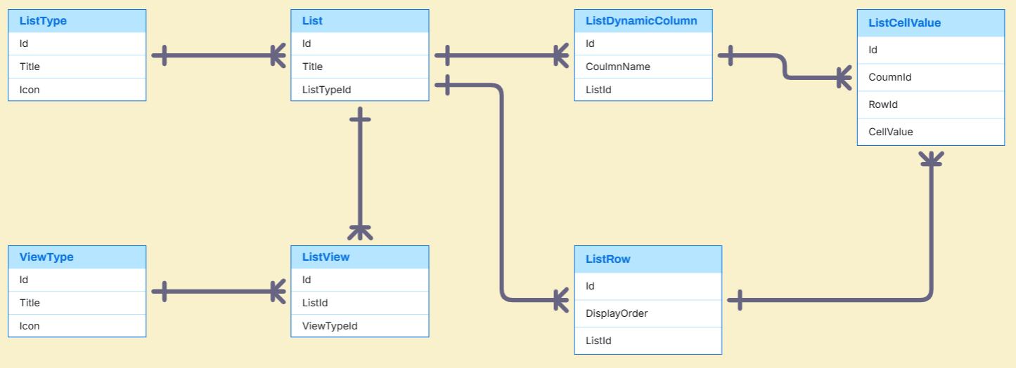
List Entities

Slide 25
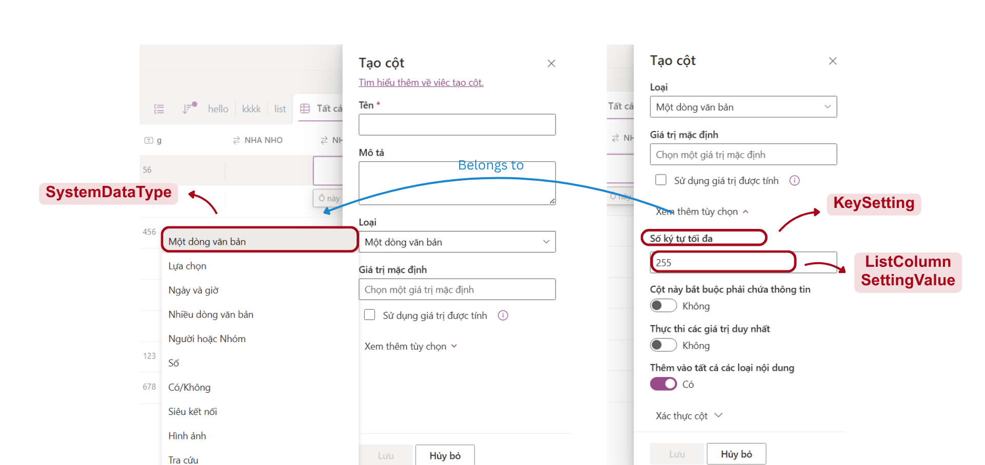
List Column Setting
Notes:
-- List Column Setting
-- Get all key setting of a specific system data type
SELECT
ks.Id, ks.KeyName, ks.DefaultValue, ks.ValueType
FROM
KeySetting ks
INNER JOIN
DataTypeSettingKey dtsk ON ks.Id = dtsk.KeySettingId
WHERE
dtsk.DataTypeId = 1
-- Get all datatype settings of a specific column
SELECT
ks.Id,
ks.KeyName,
ks.DefaultValue,
ks.ValueType,
lcsv.KeyValue
FROM
KeySetting ks
INNER JOIN
DataTypeSettingKey dtsk ON ks.Id = dtsk.KeySettingId
LEFT JOIN
ListColumnSettingValue lcsv
ON dtsk.Id = lcsv.DataTypeSettingKeyId
AND lcsv.ColumnId = 1
WHERE
dtsk.DataTypeId = 1;

Slide 26
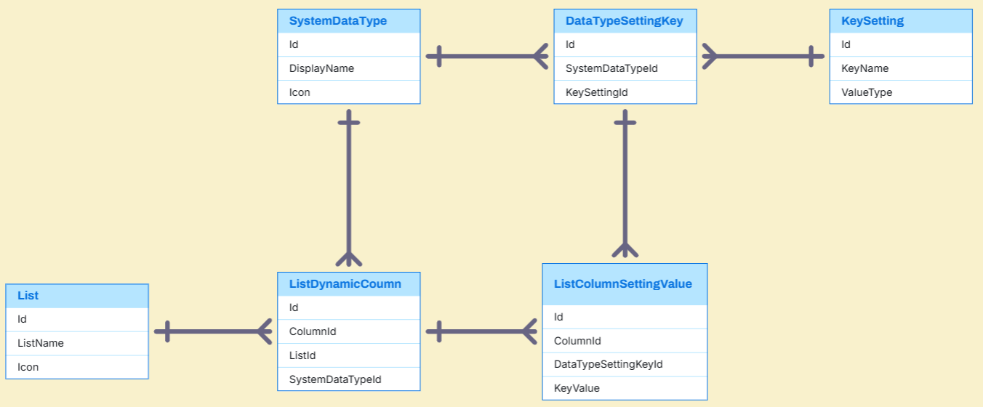
List Column Setting Entities

Slide 27
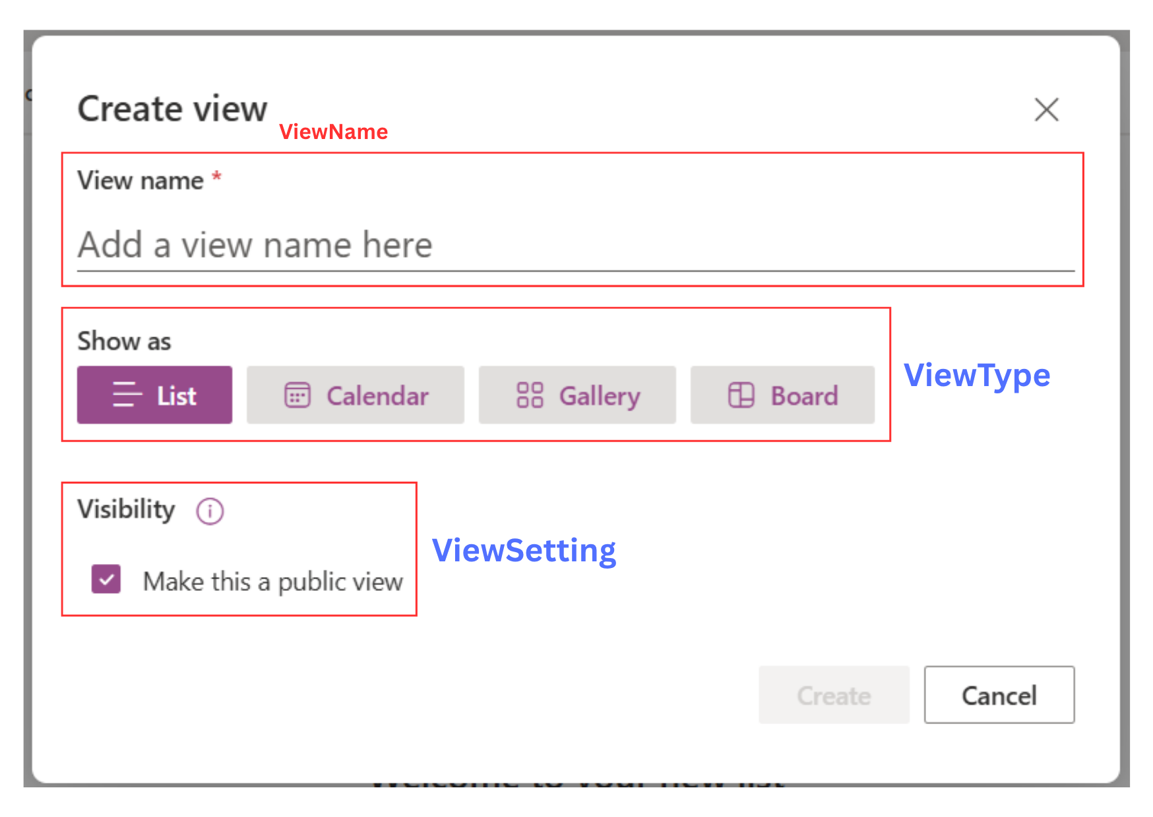
List View
Notes:
-- List View
-- Get all view types
SELECT
vt.Id, vt.Title, vt.[Description], vt.Icon
FROM
ViewType vt
-- Get all settings of a specific view type
SELECT
vs.Id,
vs.SettingKey,
vs.ValueType
FROM
ViewSetting vs
INNER JOIN
ViewTypeSetting vts ON vs.Id = vts.ViewSettingId
WHERE
vts.ViewTypeId = 4;

Slide 28
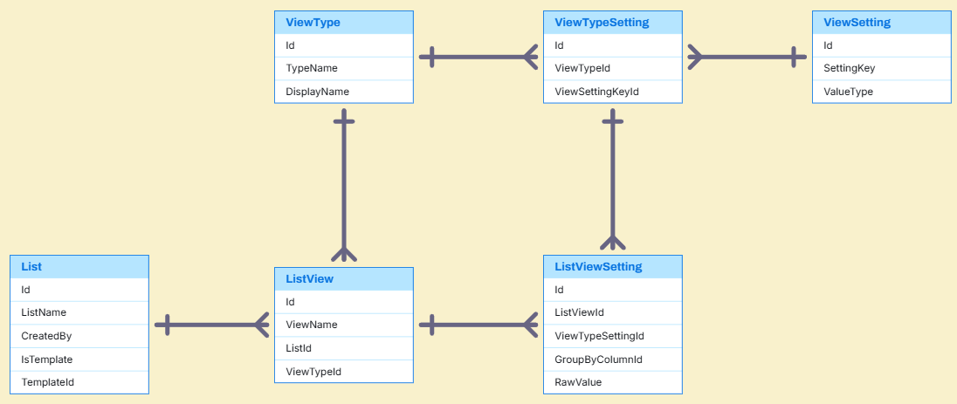
List View Entities

Slide 29
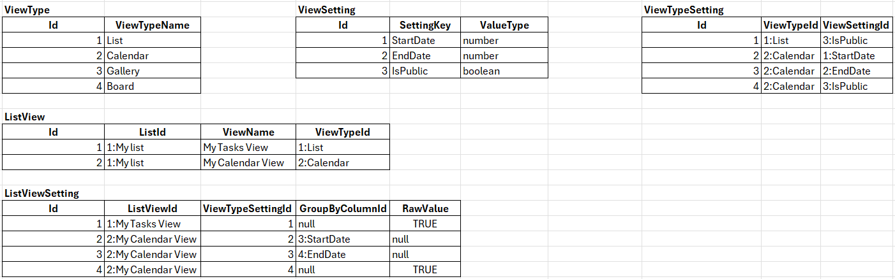
List View Sample Data

Slide 30
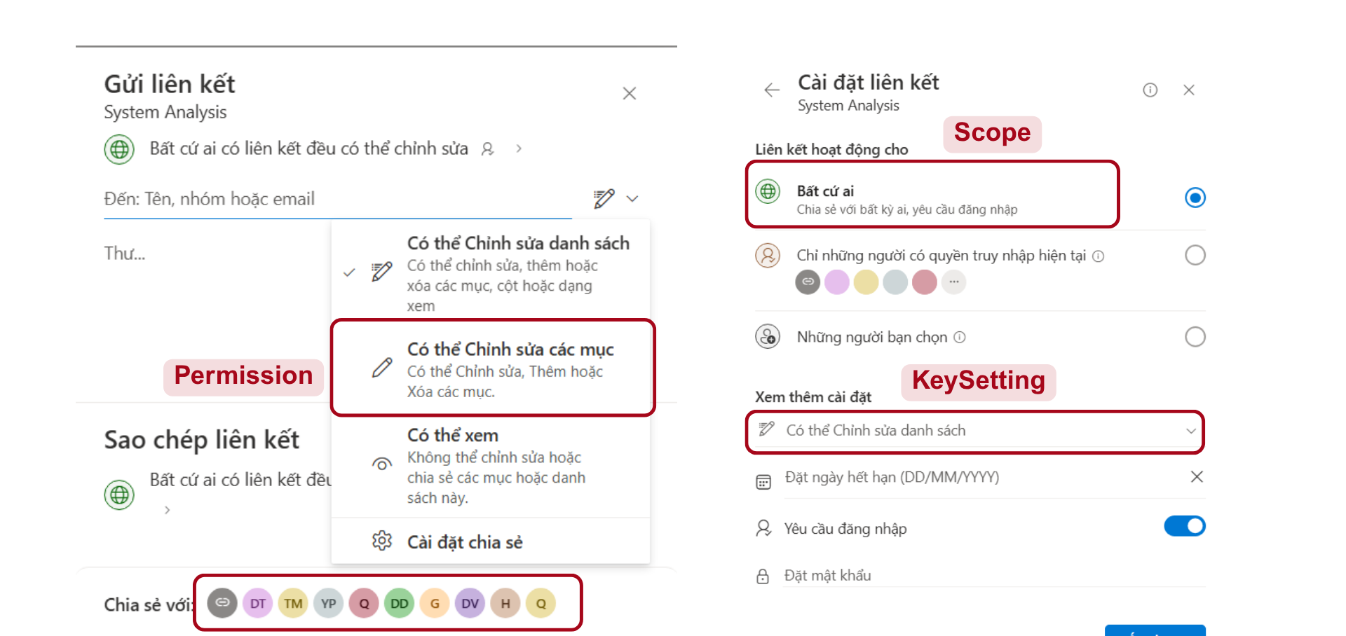
Manage Access
Notes:
-- Manage Access
-- Get all permisions
SELECT
p.Id, p.Code, p.[Name], p.Icon
FROM
Permission p
-- Get all scopes
SELECT
s.Id, s.Code, s.[Name], s.Icon, s.[Description]
FROM
Scope s
-- Get all sharelink settings
SELECT
ks.Id, ks.Icon, ks.KeyName, ks.ValueType, ks.DefaultValue
FROM
KeySetting ks
WHERE
ks.IsShareLinkSetting = 1
-- Get all current list members
SELECT
a.Avatar,
lmp.Email AS Email,
a.FirstName,
a.LastName
FROM
ListMemberPermission lmp
LEFT JOIN
Account a ON a.Id = lmp.AccountId
WHERE
lmp.ListId = 1;

Slide 31
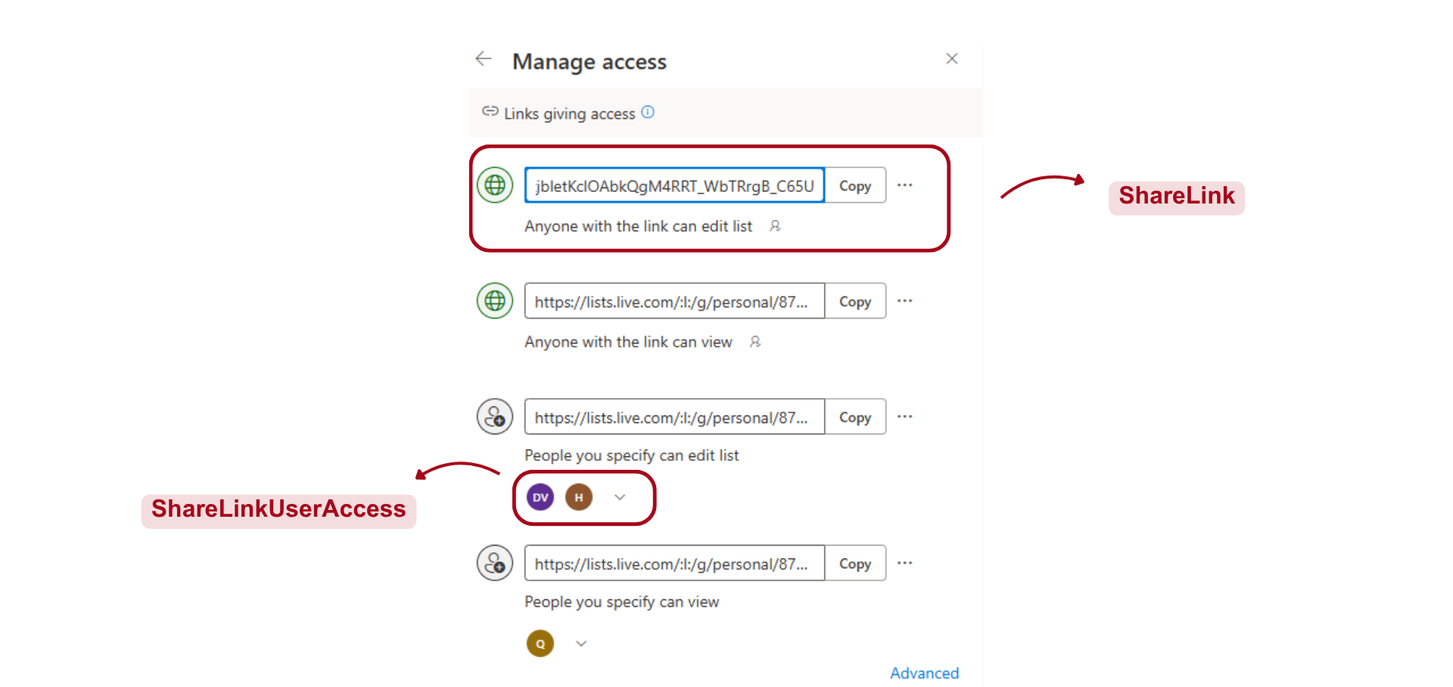
Manage Access
Notes:
-- Manage Access
-- Get all sharelinks of a specific list
SELECT
sl.Id, sl.[URL], sl.Note, p.[Name], s.Icon, a.Avatar, slua.AccountId, slua.Email
FROM
ShareLink sl
INNER JOIN
Scope s ON sl.ScopeId = s.Id
INNER JOIN
Permission p ON sl.PermissionId = p.Id
LEFT JOIN
ShareLinkUserAccess slua ON sl.Id = slua.ShareLinkId AND s.Code = 'SPECIFIC'
LEFT JOIN
Account a ON slua.AccountId = a.Id
WHERE
sl.ListId = 1
-- Get all settings of a specific sharelink
SELECT
ks.Id, ks.KeyName, ks.Icon, ks.ValueType, ks.DefaultValue, slsv.KeyValue
FROM
KeySetting ks
LEFT JOIN
ShareLinkSettingValue slsv
ON ks.Id = slsv.KeySettingId
AND slsv.ShareLinkId = 1
WHERE
ks.isShareLinkSetting = 1

Slide 32
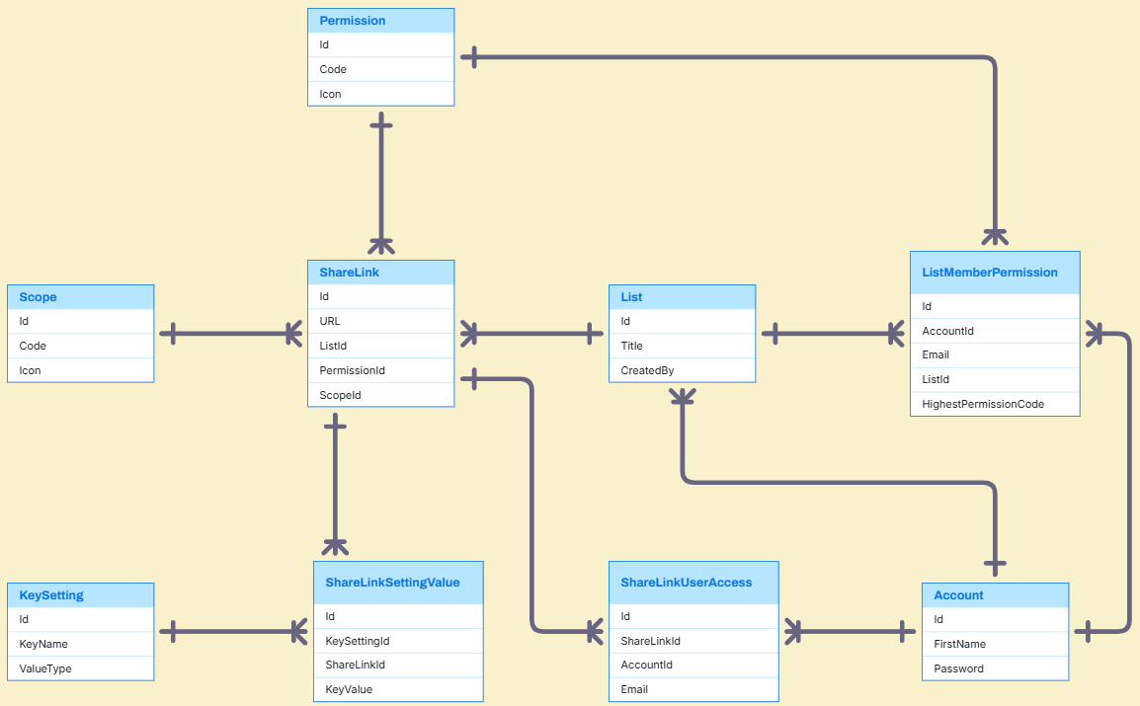
Manage Access Entities

Slide 33
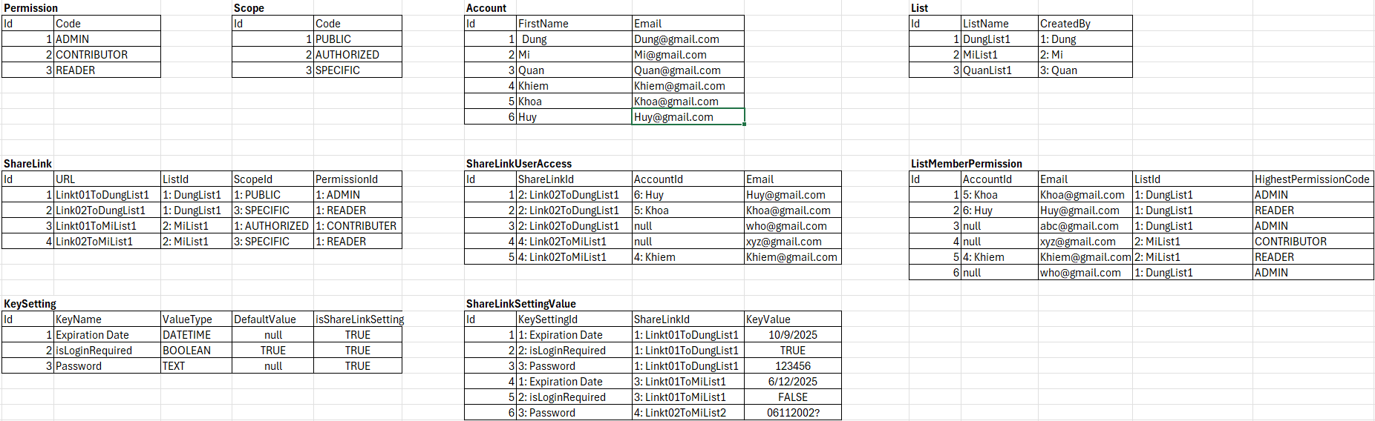
Manage Access Sample Data

Slide 34
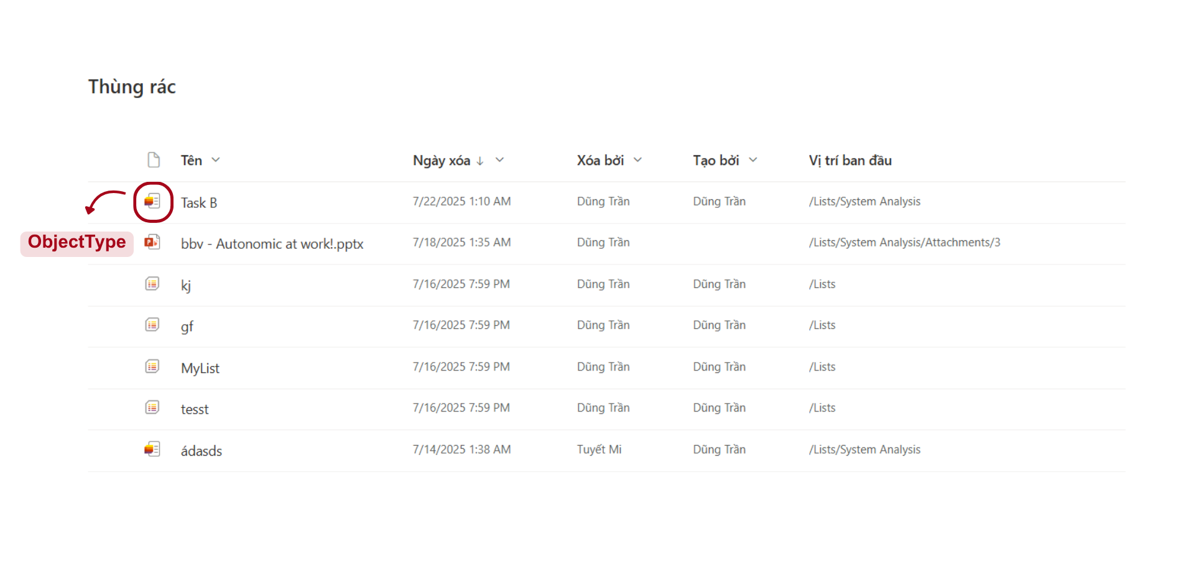
Trash
Notes:
-- SCREEN: TRASH
-- Get all trash items of a specific user
SELECT
ti.Id, ti.ObjectId, ti.ObjectName, ti.ObjectTypeId, ot.Icon, ti.DeleteBy, ti.DeletedAt, ti.ObjectStatus, ti.[Path]
FROM
TrashItem ti
INNER JOIN
ObjectType ot ON ti.ObjectId = ot.Id
WHERE
ti.CreatedBy = 1

Slide 35
Q&A

Slide 37
bbv template EN
Style guide

Slide 38
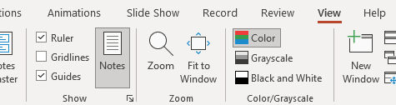


Working area, guides & ruler
Working area
Depending on the slide, a single-column layout, a 2-column or 3-column layout is used.
Display the ruler and guides in the «View» tab.

Slide 39
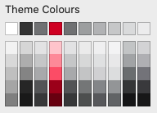
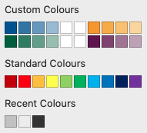
bbv colour theme
Always OK!
Never, please!
Default text colours
Main accent
Colours for diagrams, charts, graphs etc.
Use selectively and sparingly
Never, please!
Colours for diagrams, charts, graphs etc.
Colours for diagrams, charts, graphs etc.

